Slide 1
SUGGESTED READINGS:
BASIC DEFINITIONS (see Terms):
https://www.bsc.es/discover-bsc/equity-diversity-inclusion/gendered-innovations
CASE STUDIES (examples):
https://intersectionaldesign.com/experiences-and-services/

Slide 2

Bias in Science
Sex, Gender and Intersectional
analysis in Big Data
Nataly Buslon, PhD
Davide Cirillo, PhD
Barcelona Supercomputing Center
November 28, 2022

Slide 3


Social impact and ethical aspects

Slide 4
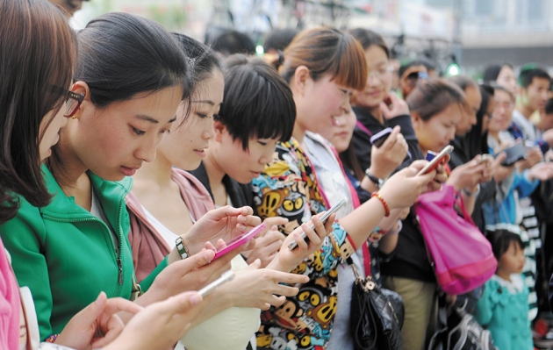



AI and Society: social impact and ethical aspects
Many choices that people consider their own are already determined by algorithms. We need information systems that are transparent, trustworthy and user-controlled.
Artificial Intelligence has a greater incidence in sectors such as: production, government, environment, education, health, etc. and it requires AI social impact assessments.
Dirk Helbing & Evangelos Pournaras.Society: Build digital democracy. Nature 527, 33–34 (2015) doi:10.1038/527033a

Slide 5
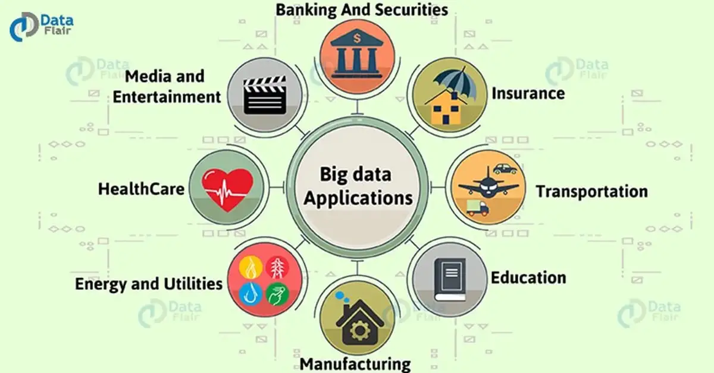
AI and Society: social impact and ethical aspects

Slide 6
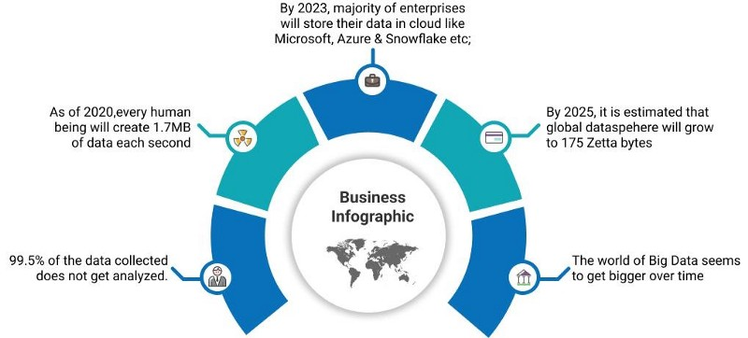
AI and Society: social impact and ethical aspects

Slide 7

AI and Society: social impact and ethical aspects
Article 27
Everyone has the right freely to participate in the cultural life of the community, to enjoy the arts and to share in scientific advancement and its benefits.

Slide 8




SOCIAL IMPACT
Social impact are the social improvements achieved as a consequence of implementing the results of a particular research project or study. Our societies have already defined societal challenges and goals (such as EU2020 targets, UN Sustainable Development Goals, etc.) and need research developments and innovations to address them.

Slide 9
SIOR: Social Impact Indicators
Connection to UN Sustainable Development Goals, EU 2020 targets or other similar official targets.
Percentage of improvement achieved in relation to the starting situation.
Transferability of the impact, the actions developed based on project’s findings have been transferred to other contexts besides the original one.
Social impact published on scientific journals (with recognized impact), governmental or non-governmental official bodies.
Sustainability, the impact achieved by the action developed based on the project’s findings has showed to be sustainable throughout time.

Slide 10

UN Sustainable Development Goals https://sdgs.un.org/goals

Slide 11
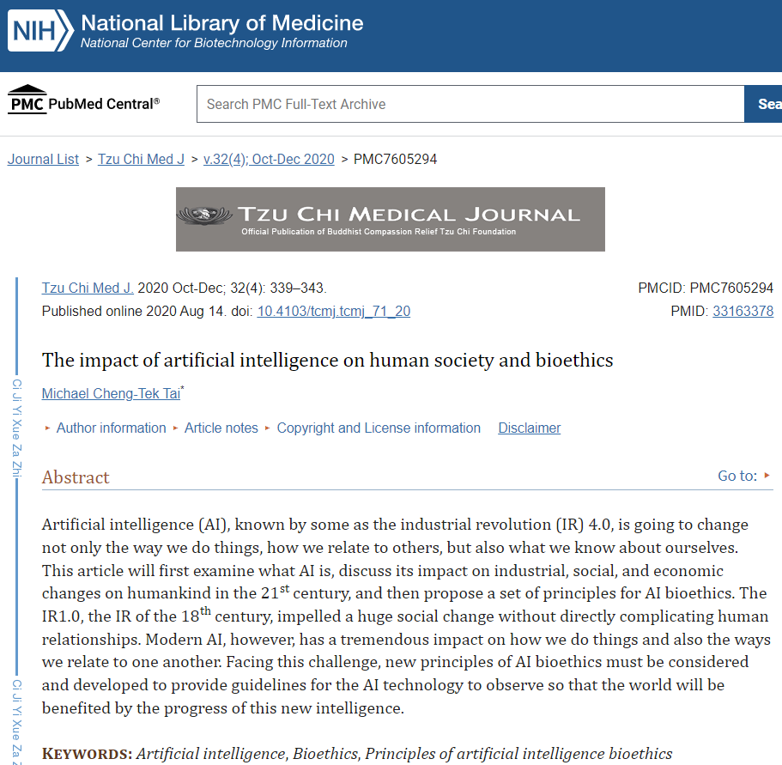
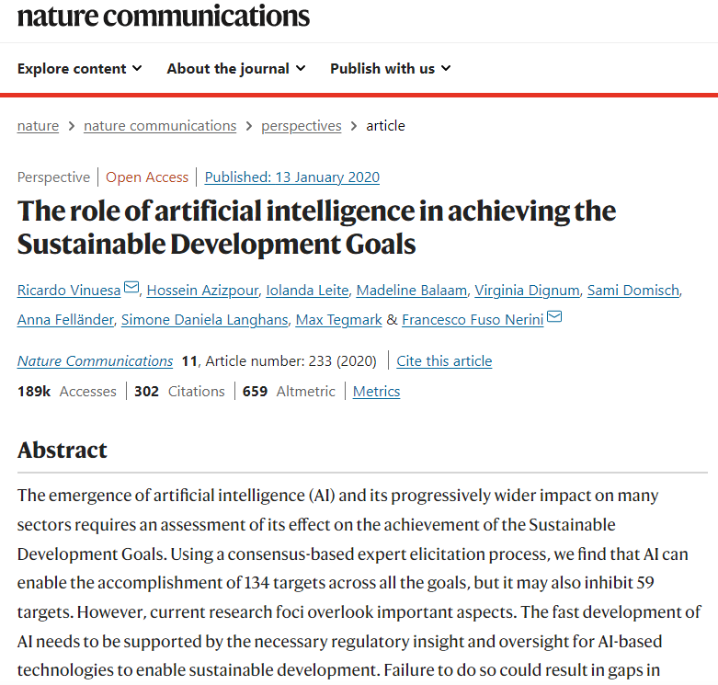


AI and Society: social impact and ethical aspects

Slide 12
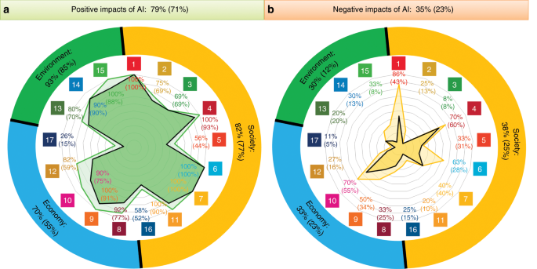
Vinuesa, R., Azizpour, H., Leite, I. et al. The role of artificial intelligence in achieving the Sustainable Development Goals.
Nature Commun 11, 233 (2020). https://doi.org/10.1038/s41467-019-14108-y

Slide 13
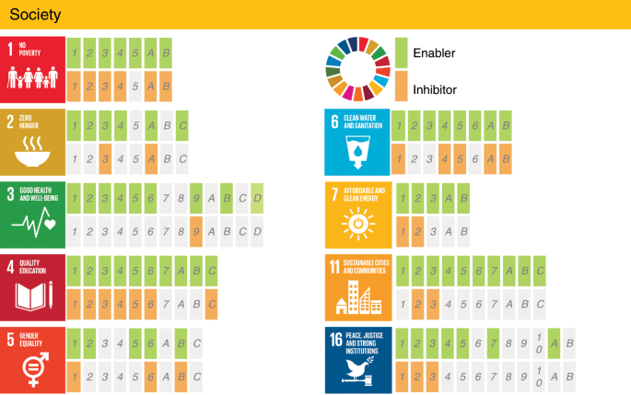

Slide 14
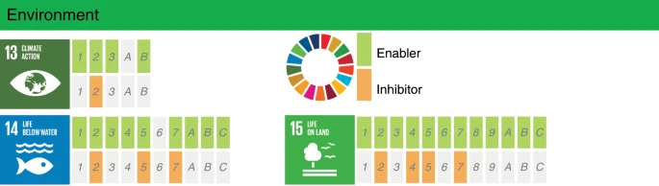
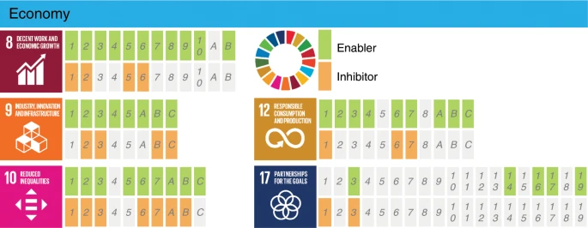
Advanced AI technology, research, and product design may require massive computational resources only available through large computing centers. These facilities have a very high energy requirement and carbon footprint. For instance, cryptocurrency applications such as Bitcoin are globally using as much electricity as some nations’ electrical demand. Some estimates suggest that the total electricity demand of information and communications technologies (ICTs) could require up to 20% of the global electricity demand by 2030, from around 1% today. Green growth of ICT technology is therefore essential. (...)
In addition to more efficient and renewable-energy-based data centers, it is essential to embed human knowledge in the development of AI models.
Vinuesa, R., Azizpour, H., Leite, I. et al. The role of artificial intelligence in achieving the Sustainable Development Goals.
Nature Commun 11, 233 (2020). https://doi.org/10.1038/s41467-019-14108-y

Slide 15

Algorithms can reduce inequalities by integrating difference, diversity and resolving the bias.
Algorithms can amplify inequalities if we develop tools, designs and research with bias.

Slide 16
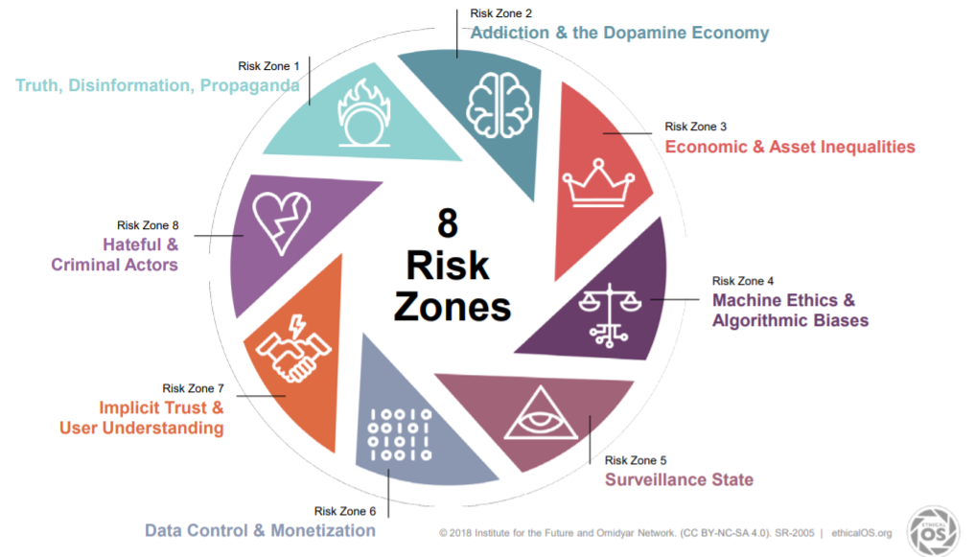
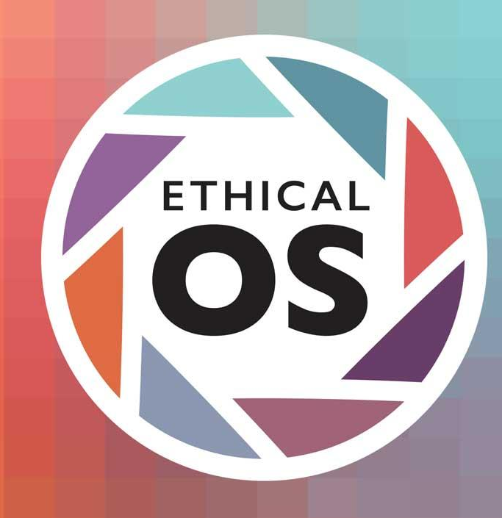

Slide 17
Social Bias
Statistic Bias
Cognitive Bias
Sex / Gender
Racial /Ethnicity
Age
Religious
Cultural
Lingüístic
Geographic
Political
Educational
Economic
Technological
Validity
Completeness
Gathering process
Noise or Spam
…..
Anchoring bias
Confirmation bias
Conservatism bias
Information bias
Overconfidence
Placebo effect
Selective perception
Stereotyping
Survivorship bias
Ricardo Baeza-Yates. 2016. Data and algorithmic bias in the web. (WebSci ’16). Association for Computing Machinery, New York, NY, USA, 1.

Slide 18
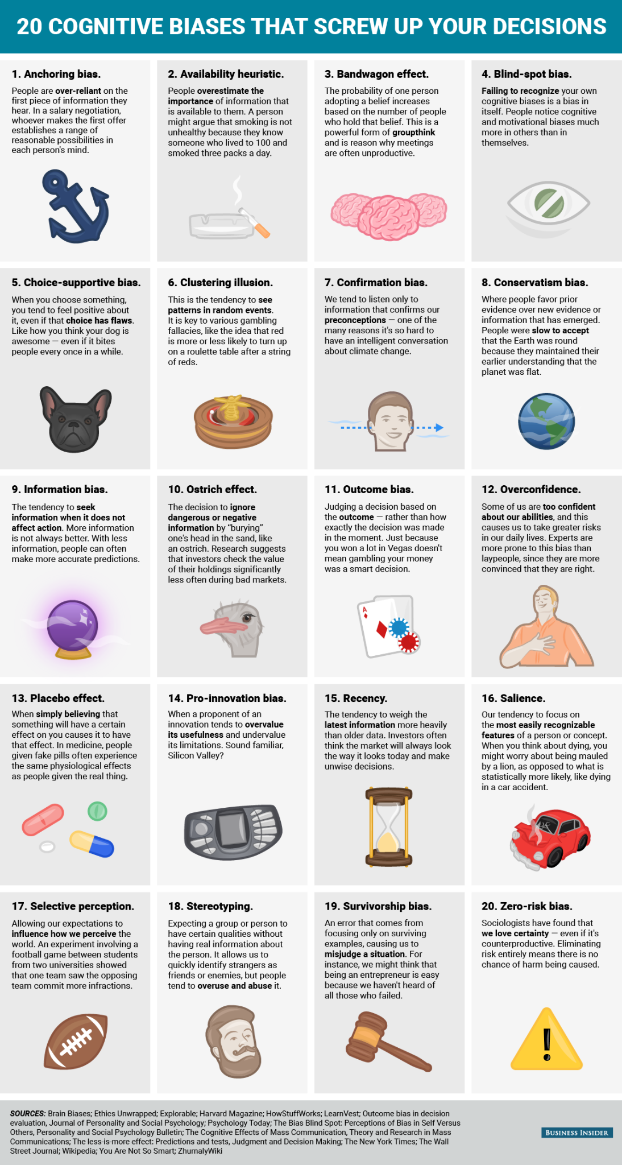
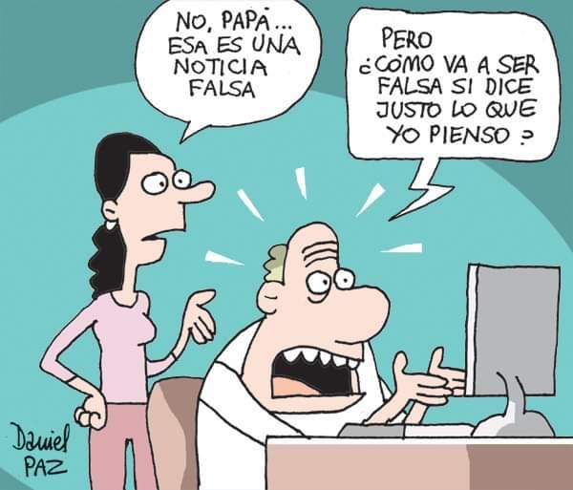
Confirmation Bias
No, Dad.. this is a fake news.
But How can it be fake if it says exactly what I think!

Slide 19




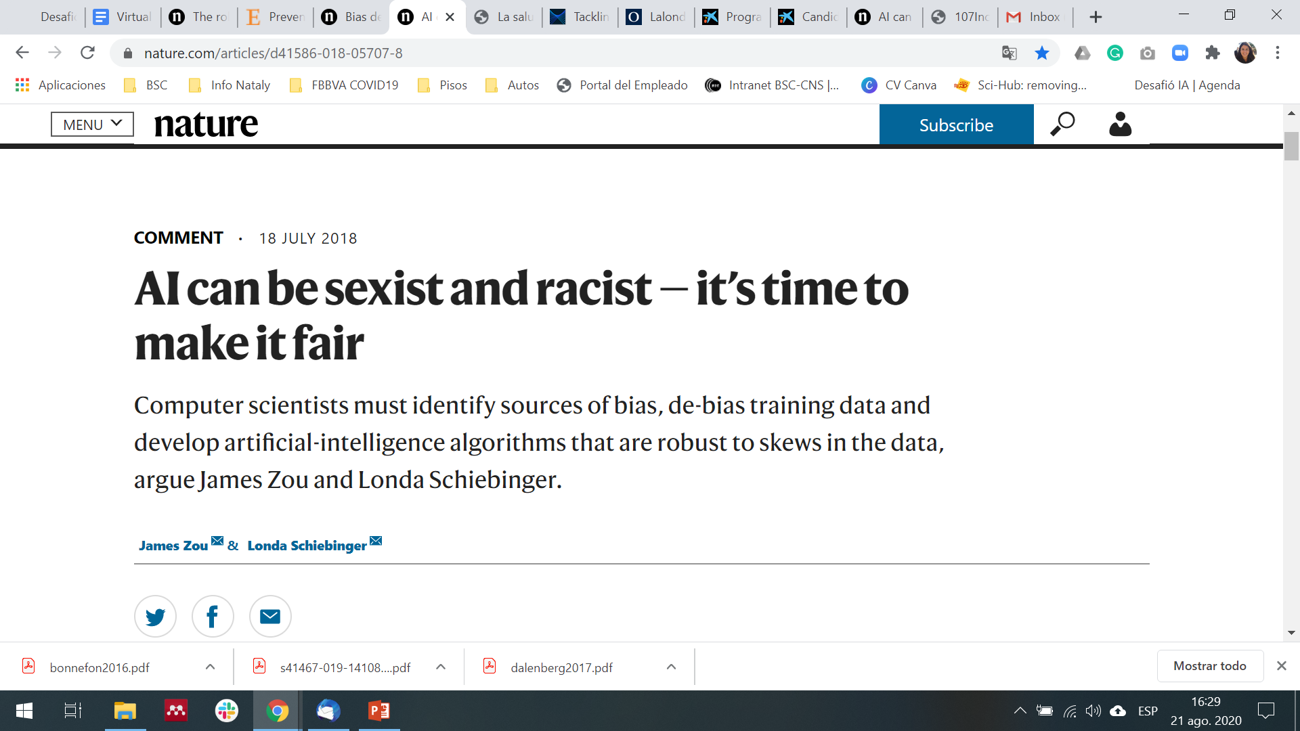

More than 45% of ImageNet data, which fuels research in computer vision, comes from the United States, home to only 4% of the world’s population.
By contrast, China and India together contribute just 3% of ImageNet data, even though these countries represent 36% of the world’s population.
https://www.nature.com/articles/d41586-018-05707-8

Slide 20
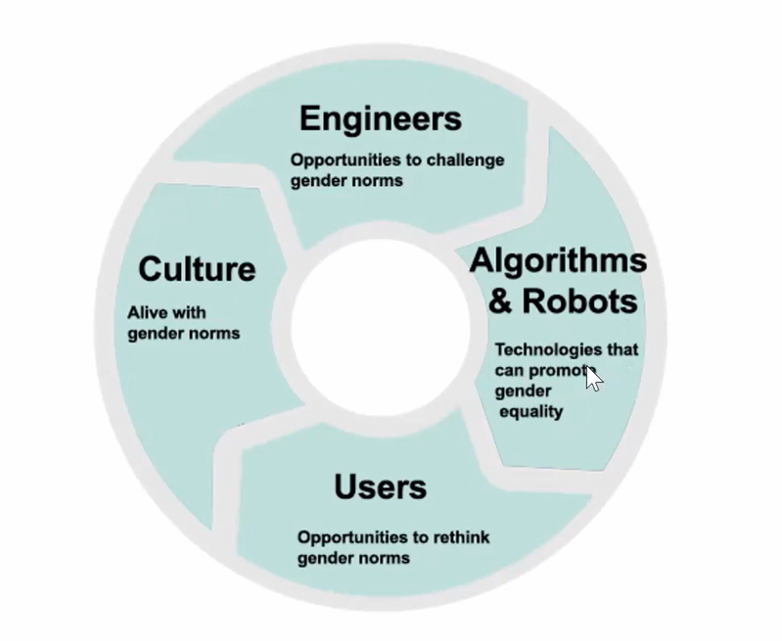


AI and Society: social impact and ethical aspects
https://intersectionaldesign.com/experiences-and-services/

Slide 21
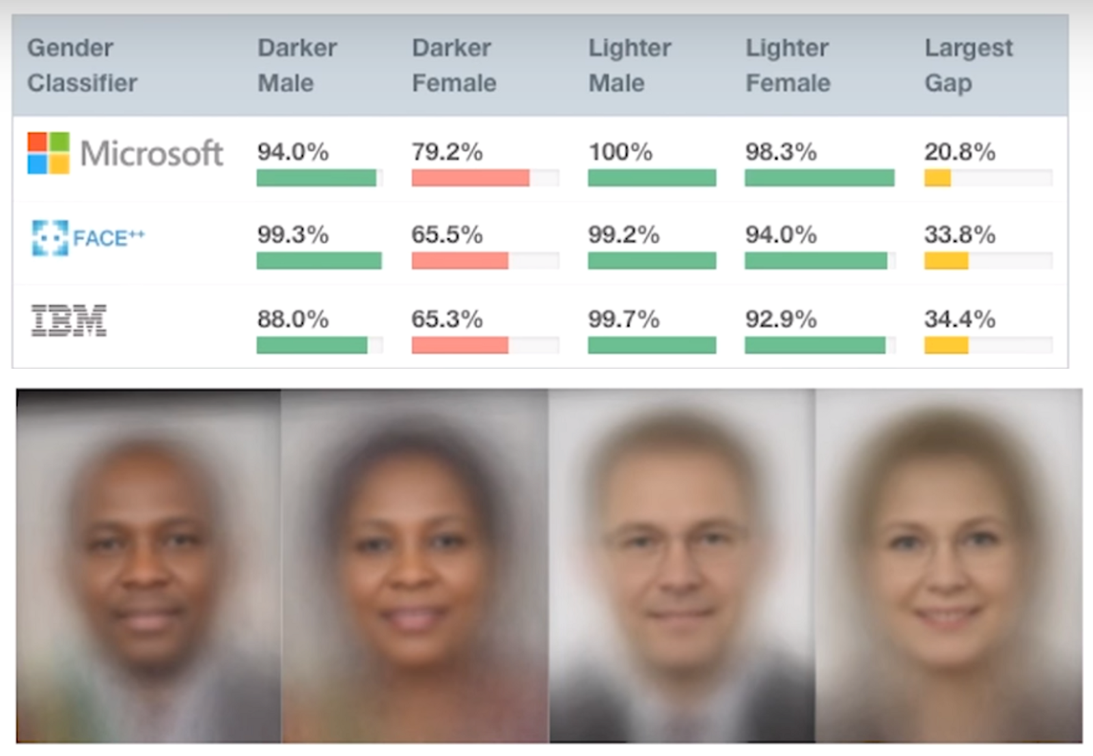
Facial Recognition
Factors: Gender, Race
Examination of facial-analysis software shows error rate of 0.8 percent for light-skinned men, 34.7 percent for dark-skinned women.
The data set used to assess its performance was more than 77 percent male and more than 83 percent white.
https://intersectionaldesign.com/form-and-function/

Slide 22
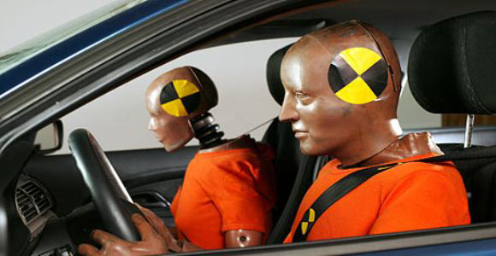
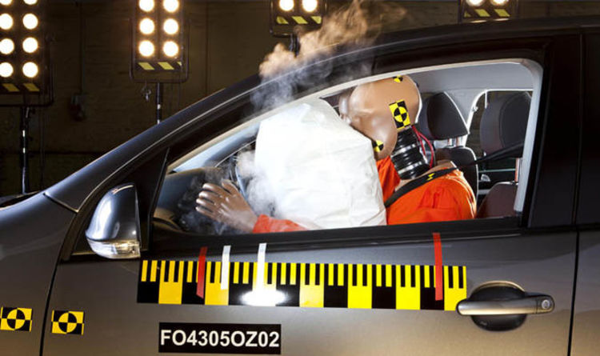
Bias vehicle crash testing
Factors: Gender, Age
Female drivers are 47% more likely to sustain severe injuries than males in comparable crashers, when controlling for body mass. Crash test dummies have been designed to represent the mid-sided male, the 5th percentile female dummy is simply a scaled-down version of this male norm. These small dummies are often placed in the passenger's seat, which reinforces gender stereotypes and fails to protect women drivers.
Older people are more likely to experience serious injuries in almost every crash type, and older women are at greatest risk for bone fracture.
https://intersectionaldesign.com/form-and-function/

Slide 23


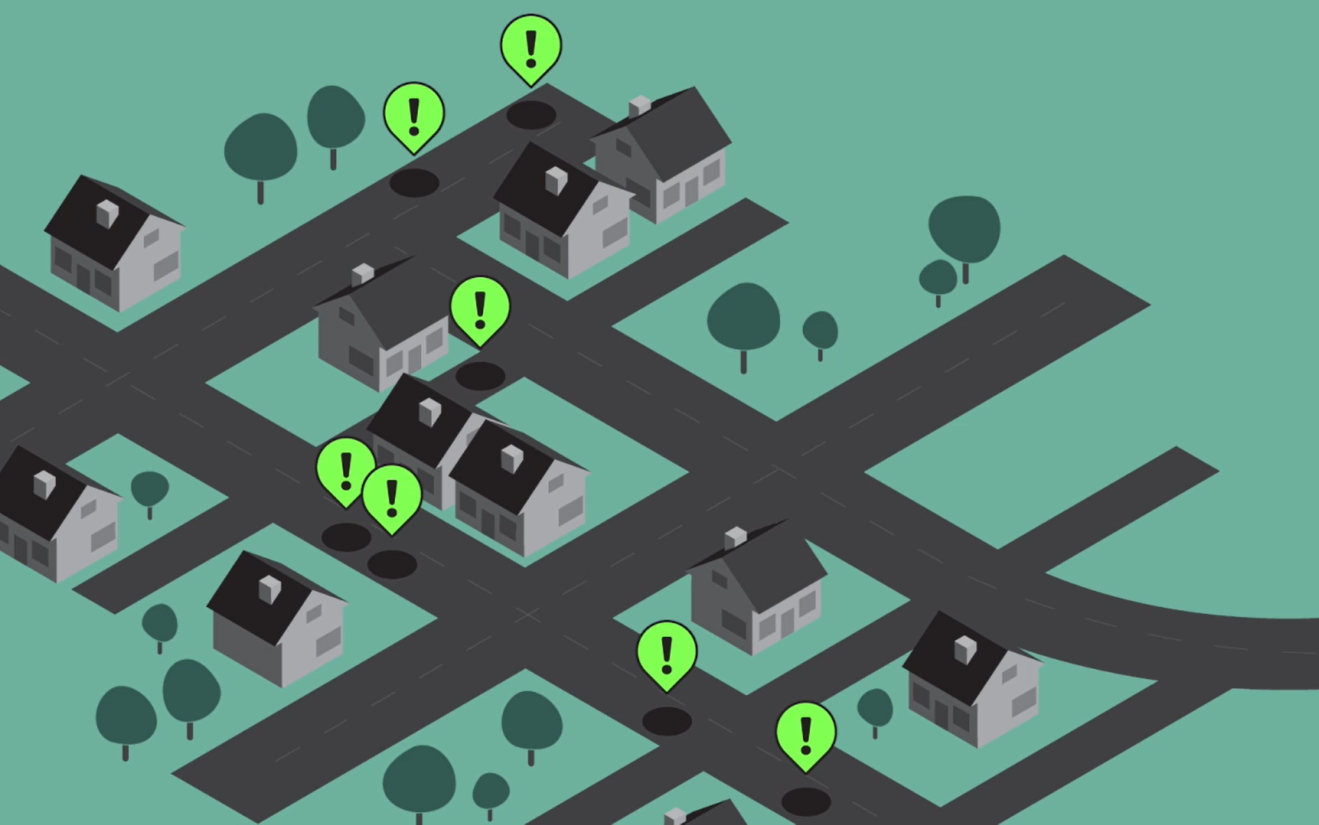
Bias Big Data Reported
Factors: age, socioeconomic status, geographical location
The system reported a disproportionate number of potholes in wealthier neighbourhoods. It turned out it was oversampling the younger, more affluent citizens who were digitally clued up enough to download and use the app.

Slide 24
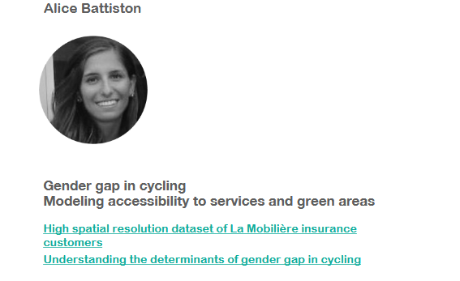
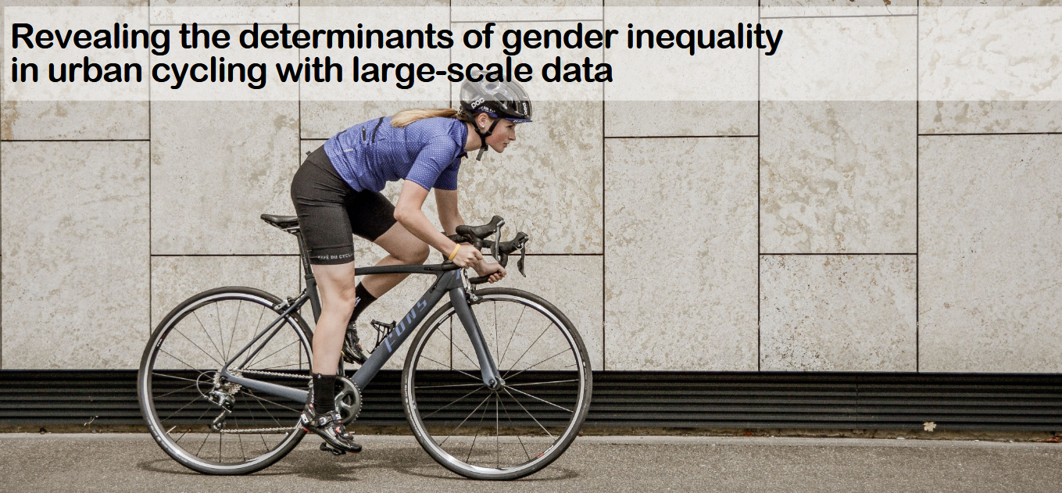
Bias Big Data Reported
Factors: gender, geographical location.
Cycling is an outdoor activity with massive health benefits, and an effective solution towards sustainable urban transport. Despite these benefits and the recent rising popularity of cycling, most countries still have a negligible uptake. This uptake is especially low for women: there is a largely unexplained, persistent gender gap in cycling. We find a positive association between female cycling rate and urban road safety. On a microscopic level, we identify female preferences for street-specific features in the city of New York. Enhancing the quality of the dedicated cycling infrastructure may be a way to make urban environments more accessible for women, thereby making urban transport more sustainable for everyone.
https://arxiv.org/abs/2203.09378

Slide 25
Trustworthy AI: From principles to practice

Slide 26
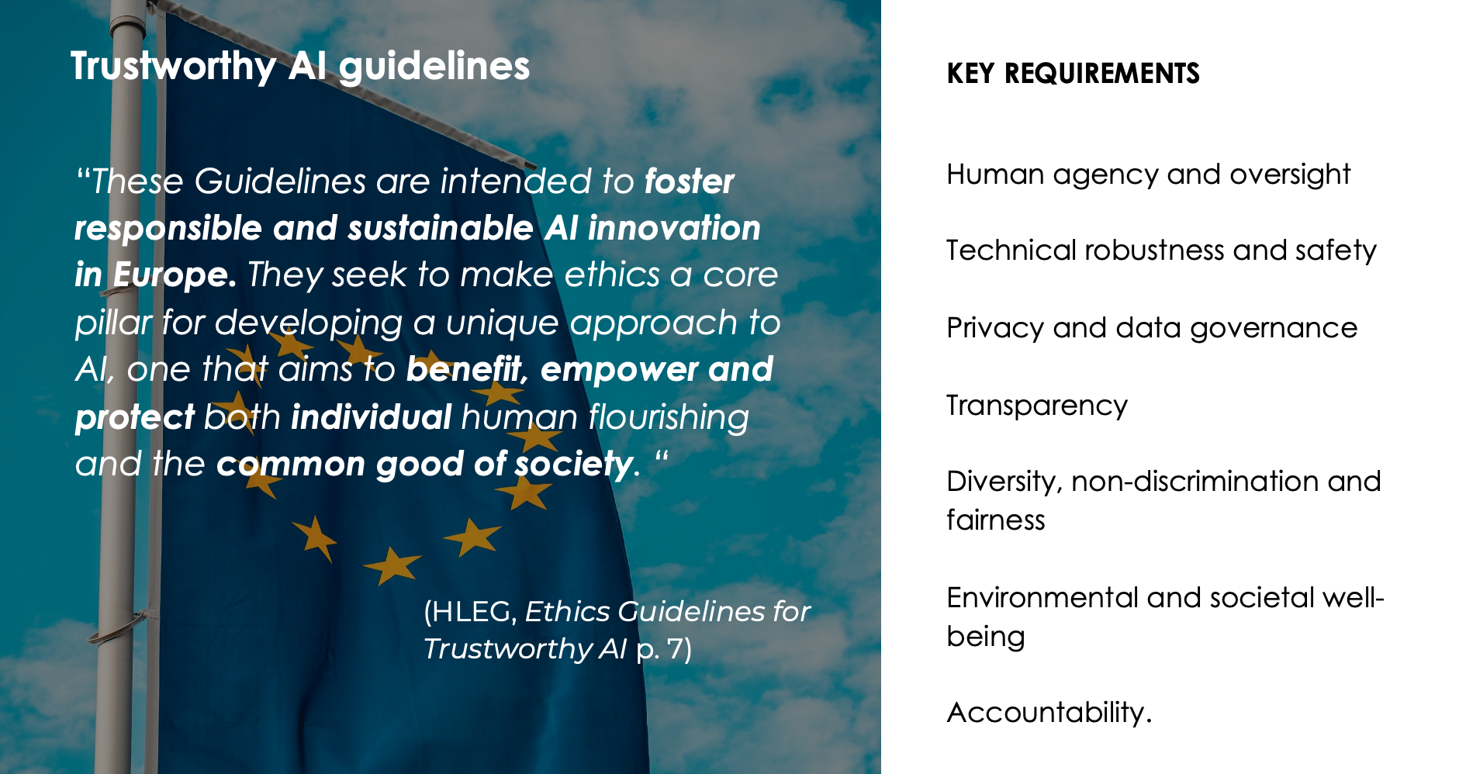

Slide 27
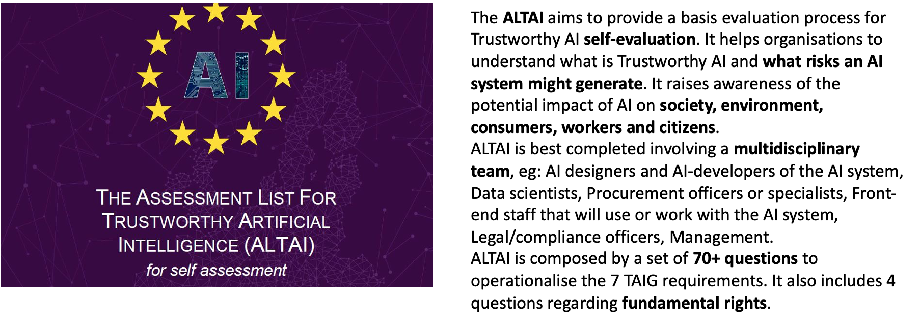
Assessment / Checklists

Slide 28
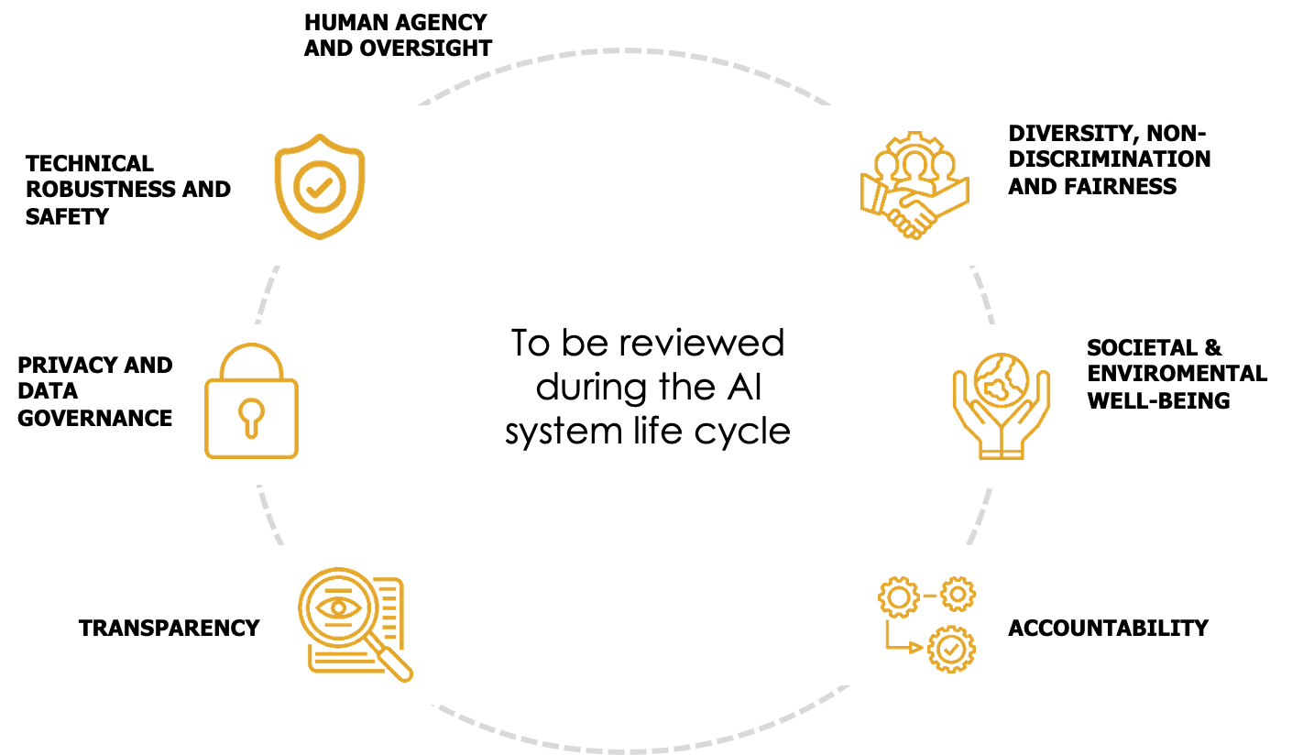
Trustworthy AI ethical requirements

Slide 29
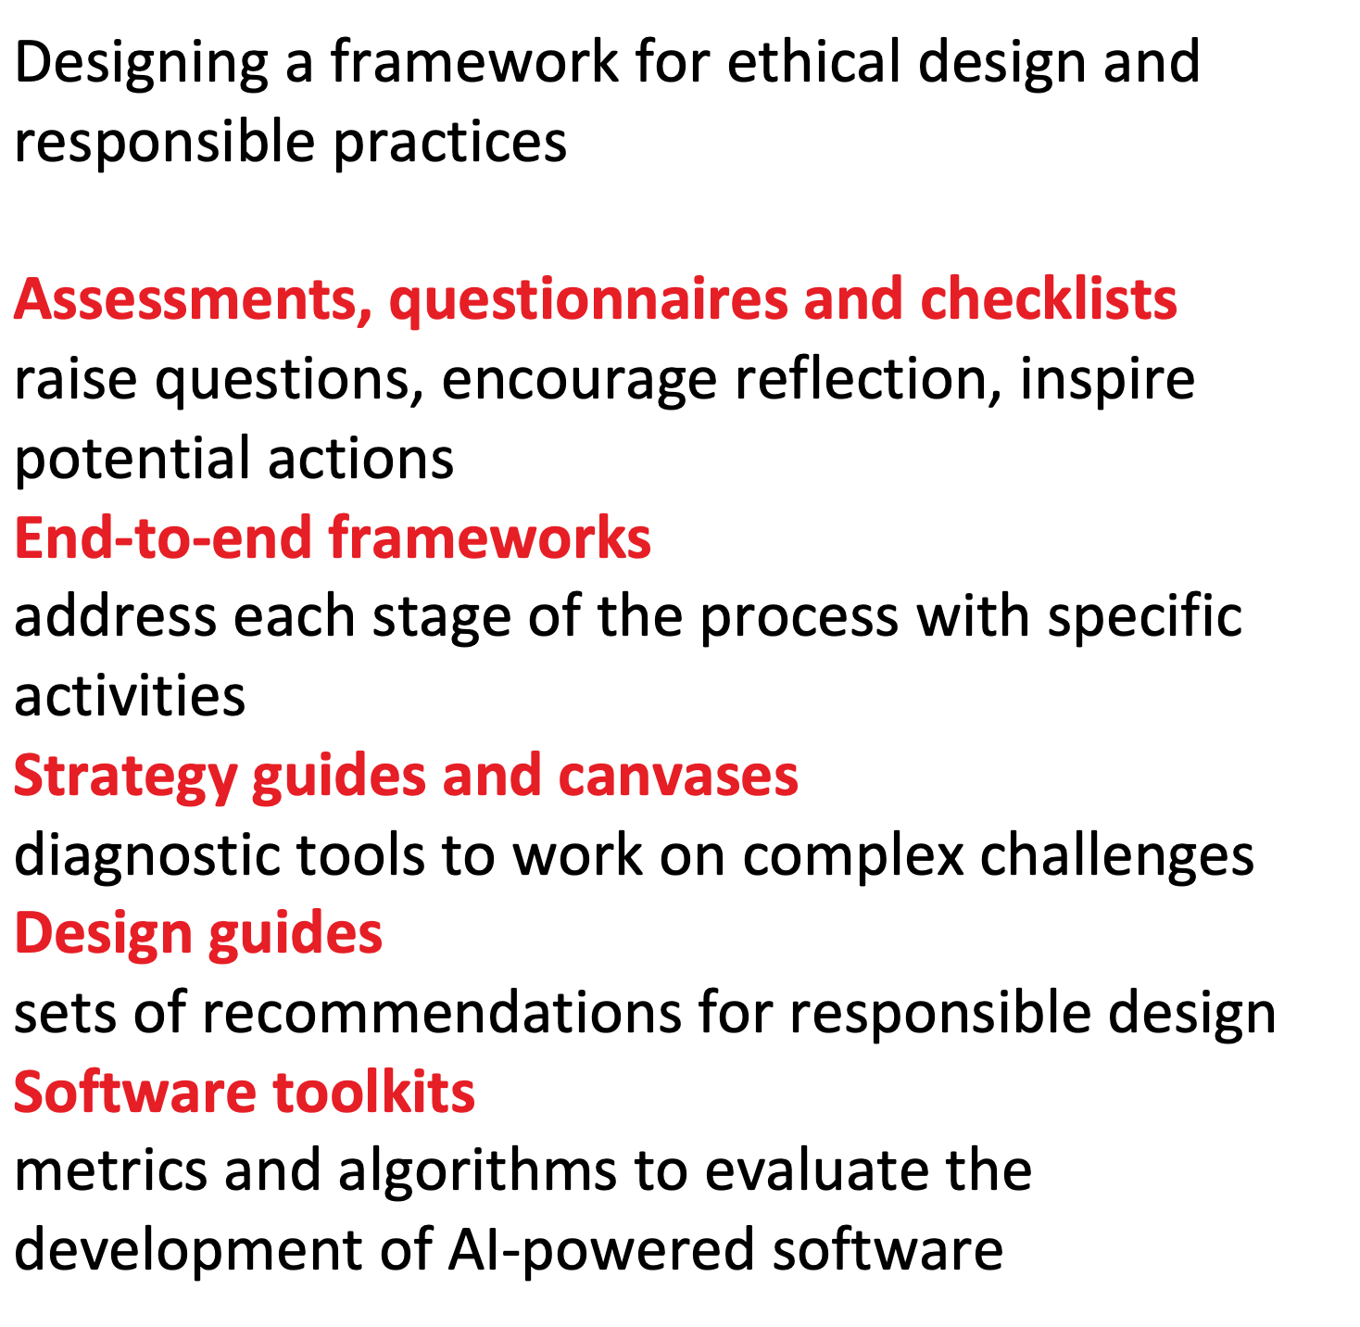
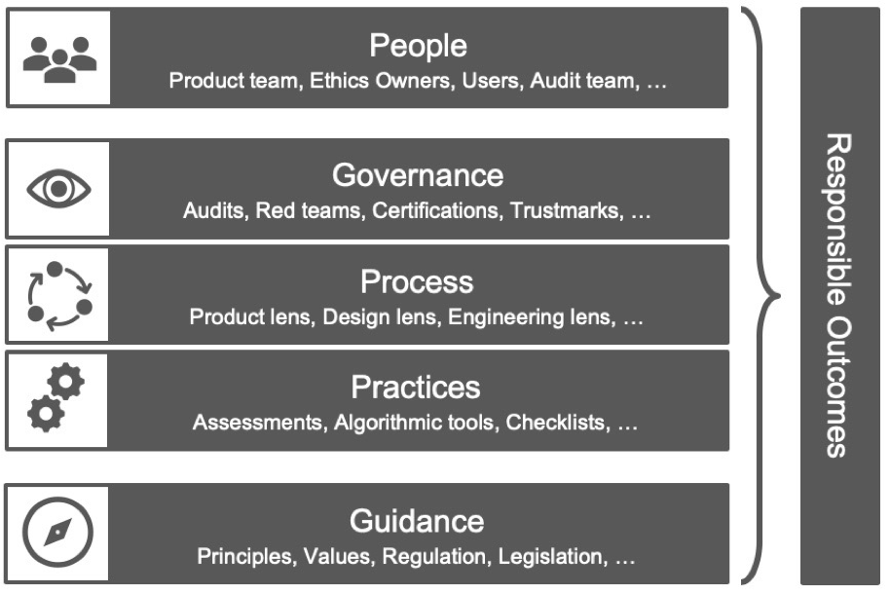
Responsible AI practices

Slide 30
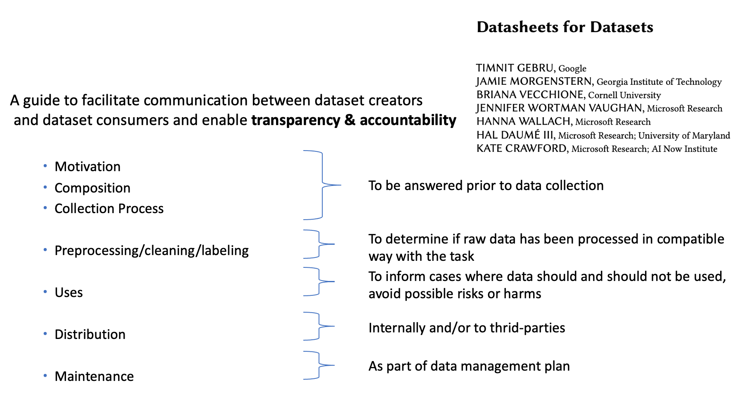
Assessment / Checklists

Slide 31
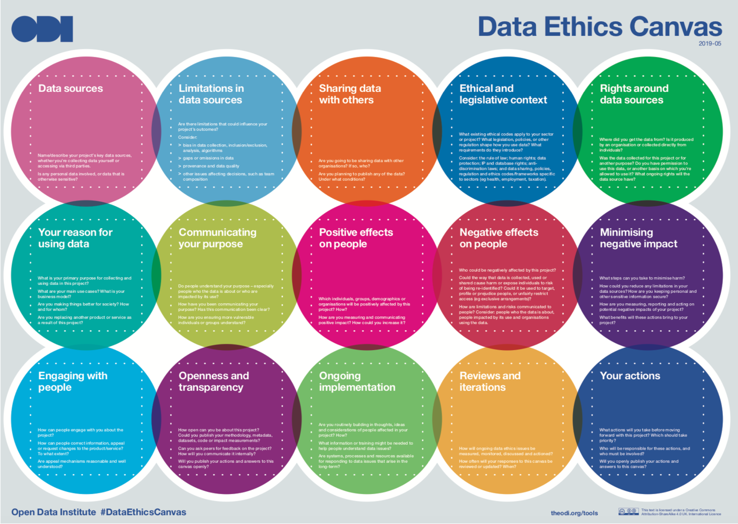
Canvases

Slide 32
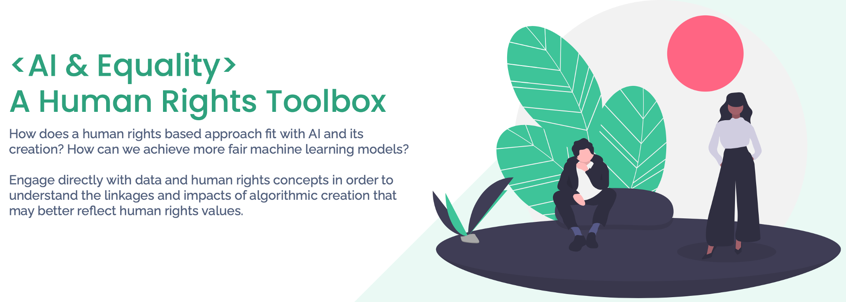
End-to-end frameworks

Slide 33
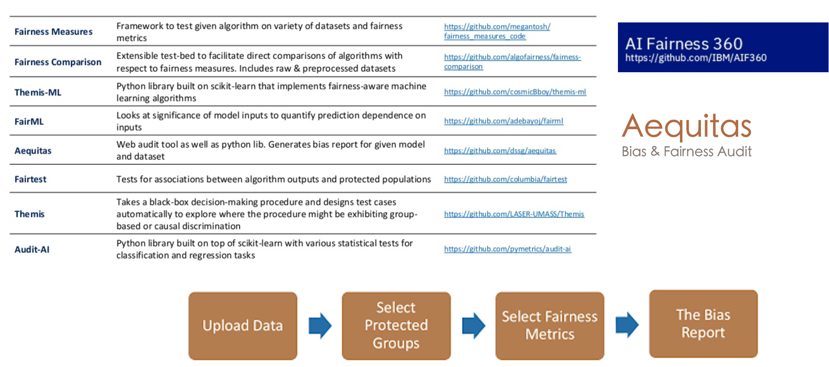
Software toolkits

Slide 34
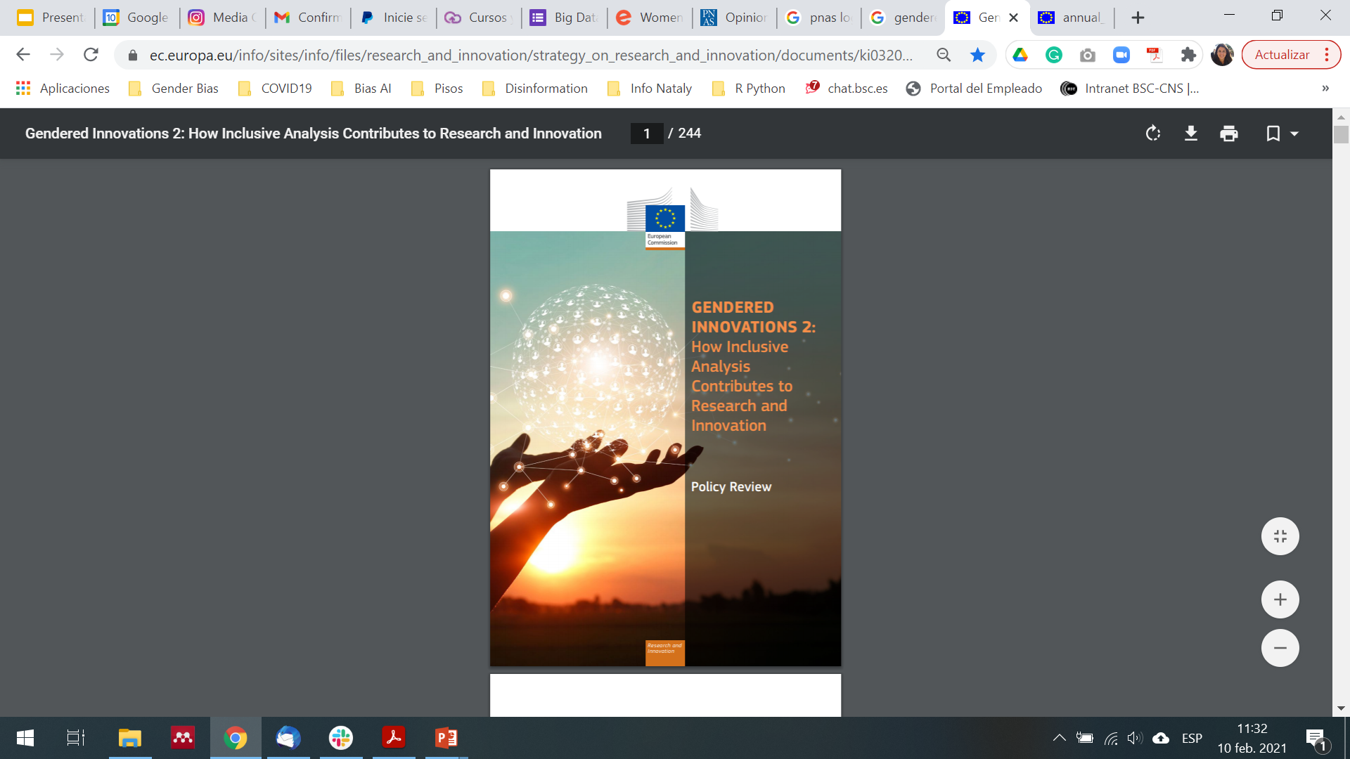
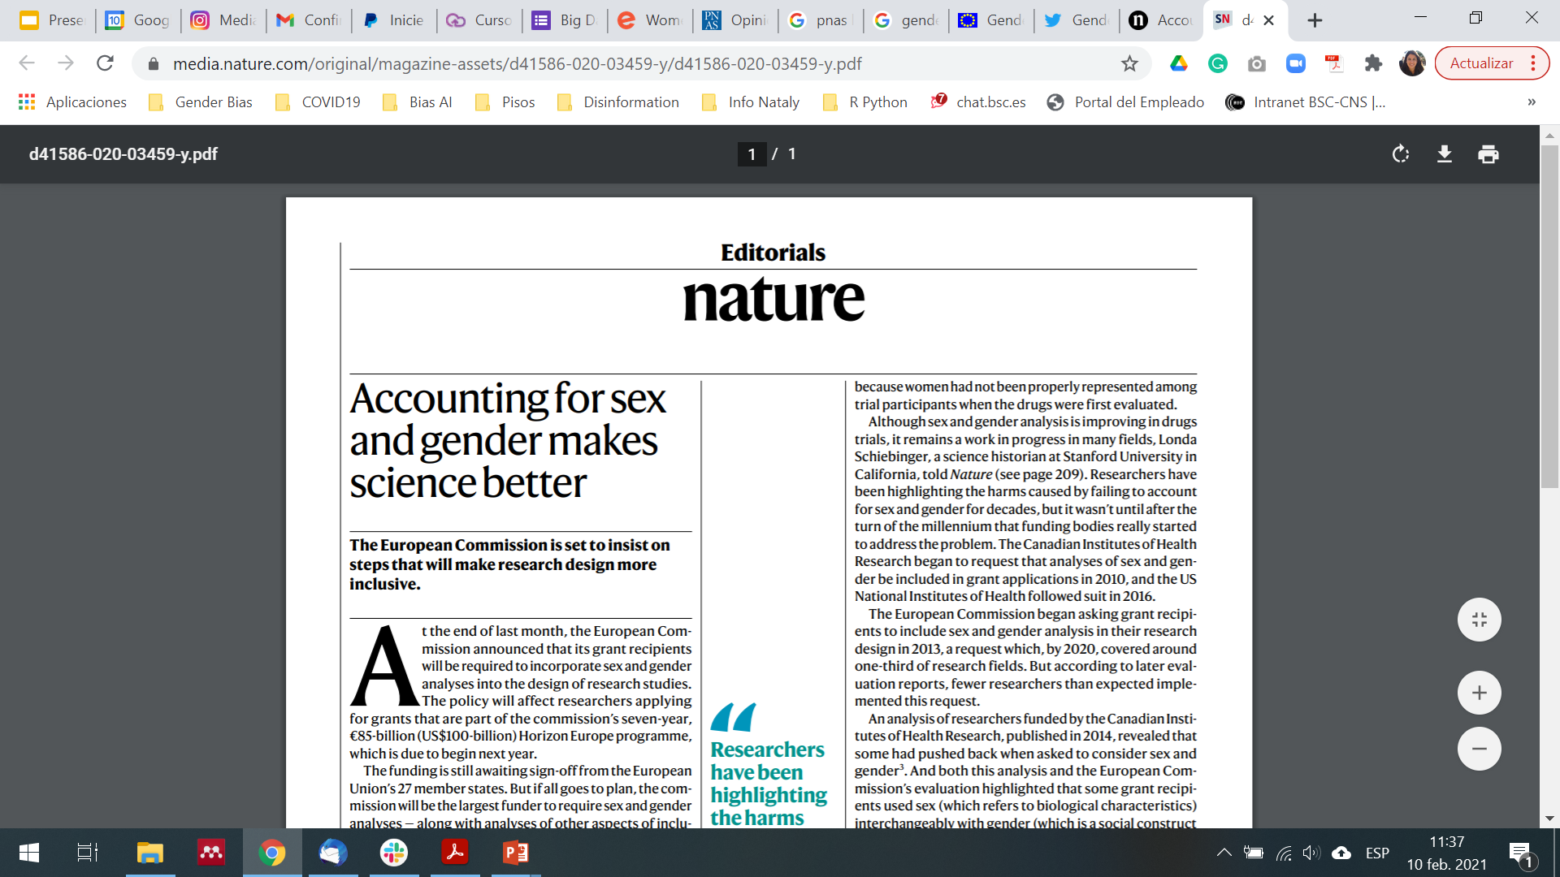

European Commission
The European Commission announced that its will be required to incorporate Sex and Gender analyses into the design of research studies. The policy will affect researchers applying for grants (...) In Horizon Europe, the requirement becomes a mandate, and is expected to extend, by default, to most grant recipients.
https://op.europa.eu/en/publication-detail/-/publication/33b4c99f-2e66-11eb-b27b-01aa75ed71a1/language-en

Slide 35

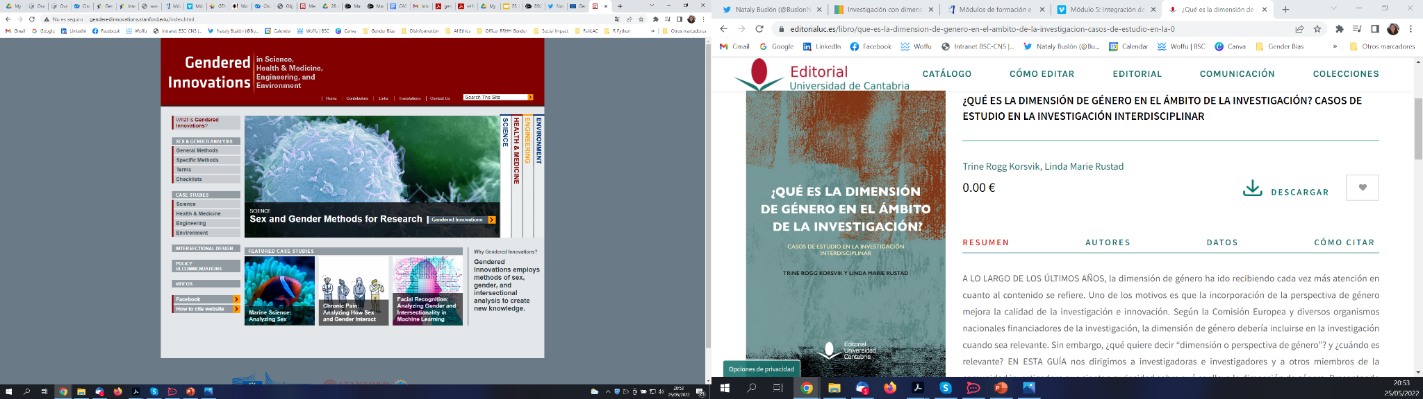
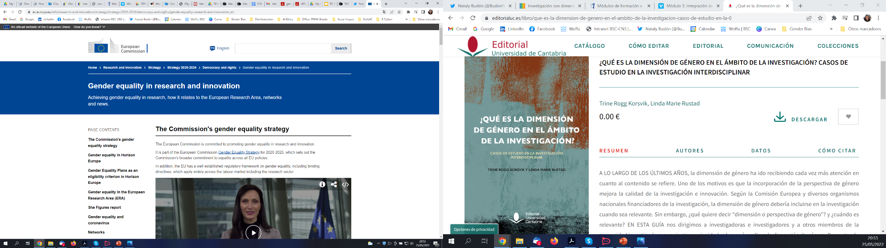
Resources
Gendered Innovations
Comisión Europea Recomendaciones
Guías Dimensión de Género en Investigación
https://ec.europa.eu/info/research-and-innovation/strategy/strategy-2020-2024/democracy-and-rights/gender-equality-research-and-innovation_en
https://www.editorialuc.es/libro/que-es-la-dimension-de-genero-en-el-ambito-de-la-investigacion-casos-de-estudio-en-la-0
http://genderedinnovations.stanford.edu/index.html

Slide 36
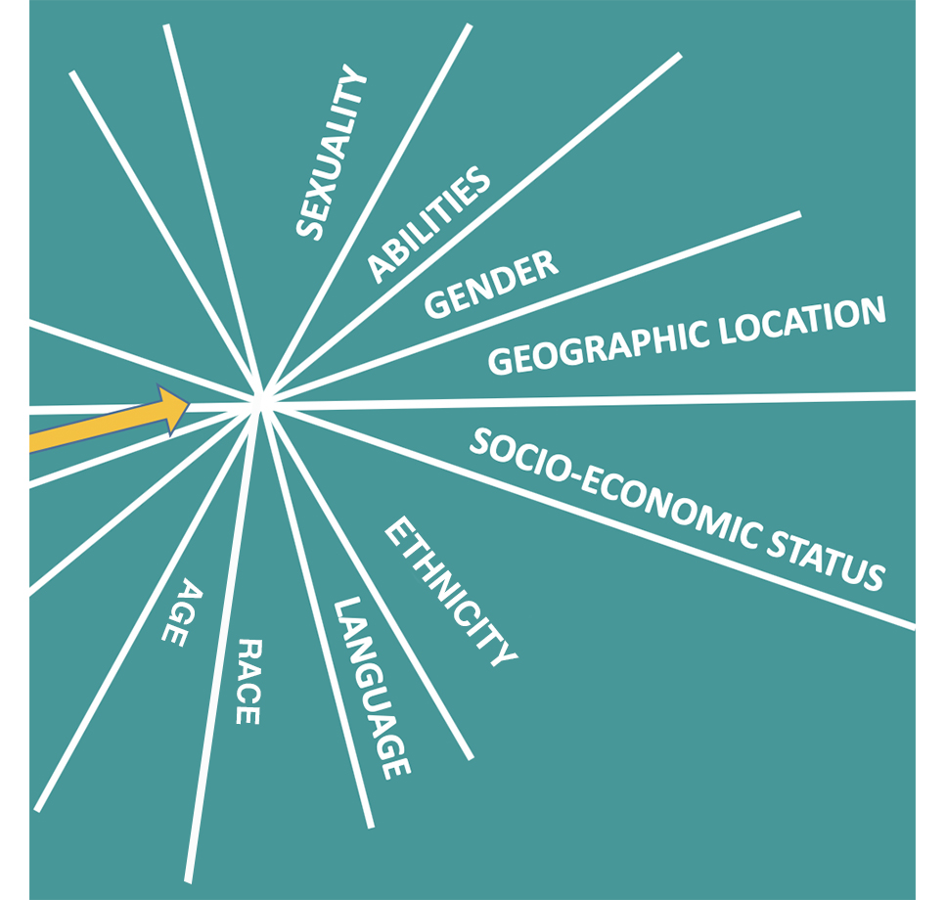
Intersectionality
Intersectionality describes overlapping or intersecting forms of discrimination related to gender, sex, ethnicity, age, socioeconomic status, sexuality, geographic location, disabilities, etc.
Researchers should not consider one factor isolated. We need to analyze relations that shape social attributes.
http://genderedinnovations.stanford.edu/terms/intersectionality.html

Slide 37
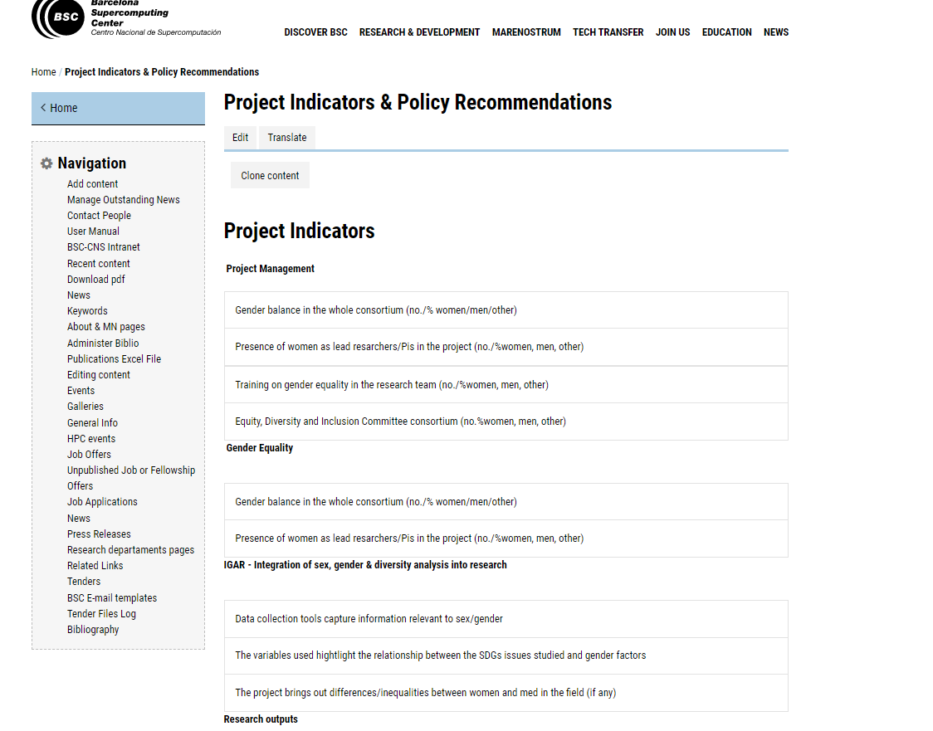

GenderNET PLUS
H2020 ERA

Slide 38
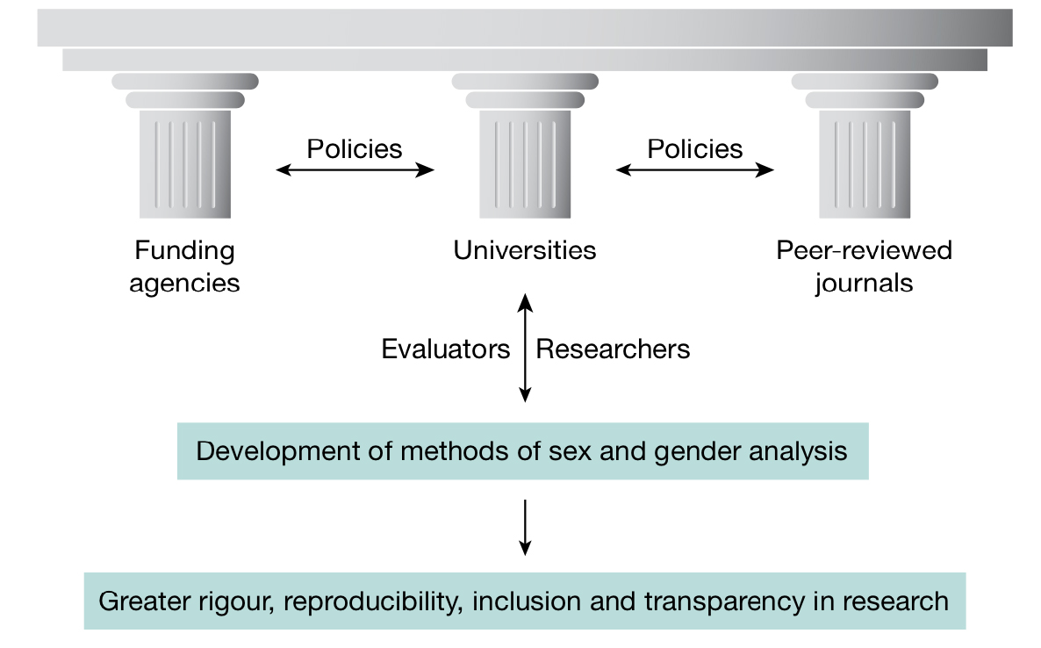
1. Granting Agencies can ask applicants to explain how sex and gender analysis is relevant in their proposed research. The Euruopean Commission has implemented the Gender Equality Plan (GEP) elegibility criterion (2022). This is defined as a set of mandatory requirements for all public bodies, higher education institutions and research organisations from Member States and Associated Countries wishing to participate in Horizon Europe.
2. Editors of Peer-Reviewed Journals and Peer-Reviewed AI Conferences can require sophisticated sex and gender analysis when selecting papers for publication or conference presentation.
3. Universities need to step up and incorporate sex and gender analysis as conceptual tools into the core curriculum of natural science, health & medicine, engineering, and environmental science. Universities must do more to prepare the scientific workforce for the future.
4. Industry can incorporate the smartest aspects of gender to open new markets and enable innovation in products, processes, services, or infrastructures. Products that meet the needs of complex and diverse user groups enhance global competitiveness and sustainability.
https://intersectionaldesign.com/experiences-and-services/

Slide 39
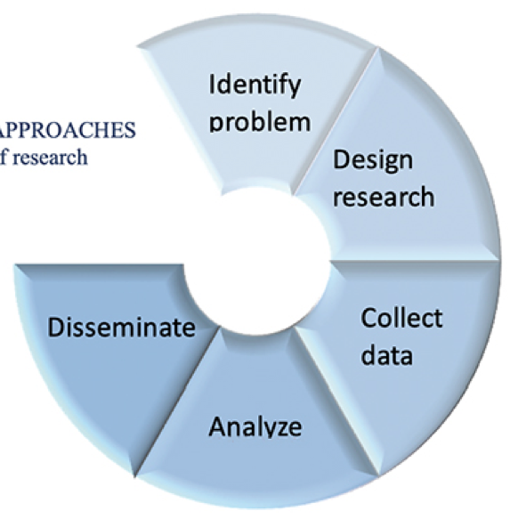

How to introduce the sex and gender perspective in research
1.- Identify problem & Research
How can we include more diverse viewpoints in the research process? How can we research beyond biases and assumptions in big data and algorithms?
How can we go about gender /race/age research, without leading or falling into stereotypes?
2. Design & Methodology Data
3.- Evaluation & Analysis
4.- Dissemination & Publications
Weber et al., 2007
Gender Research: A How-To Guide. INSTRAW / United Nations
https://genderaveda.cz/wp-content/uploads/2017/10/gender-research-a-how-to-guide.pdf

Slide 40
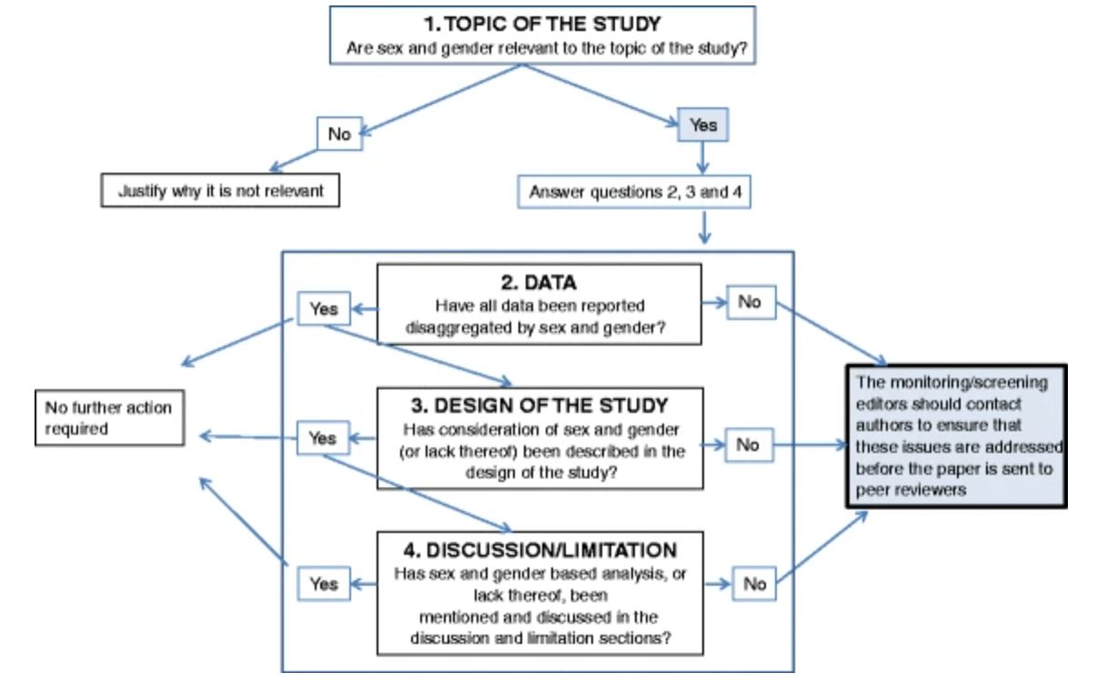
Resources
Heidari, S., Babor, T.F., De Castro, P. et al. Sex and Gender Equity in Research: rationale for the SAGER guidelines and recommended use. Res Integr Peer Rev 1, 2 (2016). https://doi.org/10.1186/s41073-016-0007-6

Slide 41
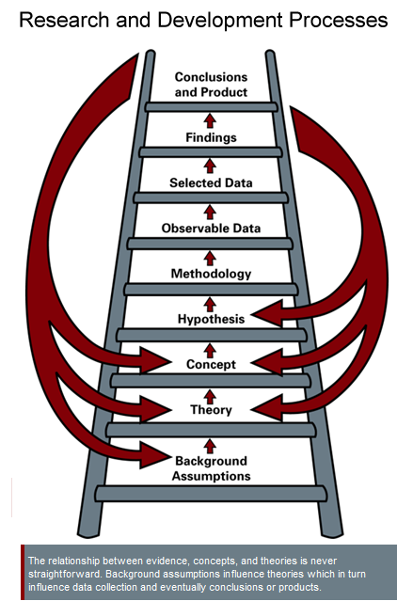
General Methods -Gendered Innovations
Rethinking Research Priorities and Outcomes
Rethinking Concepts and Theories
Formulating Research Questions
Analyzing Sex
Analyzing Gender
Analyzing how Sex and Gender Interact
Intersectional Approaches
Engineering Innovation Processes
Co-creation and Participatory Research
Rethinking Standards and Reference Models
Rethinking Language and Visual Representations
http://genderedinnovations.stanford.edu/terms/intersectionality.html

Slide 42

Sex and Gender Bias in AI and Health

Slide 43














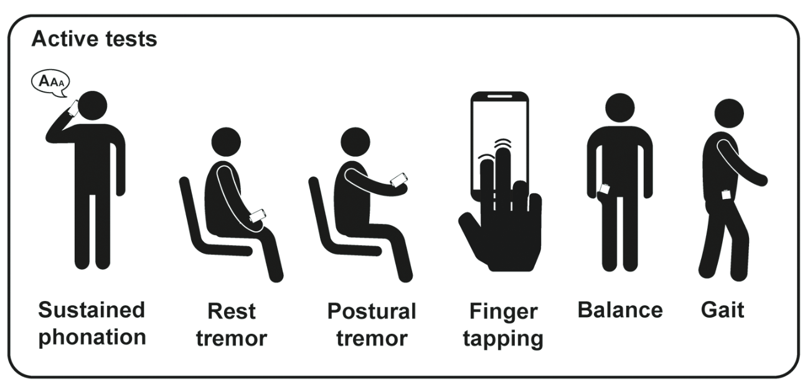

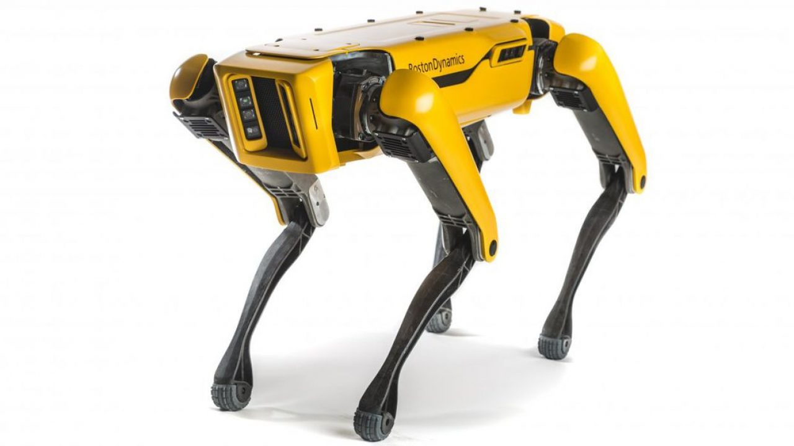
Sex and gender differences and biases in Artificial Intelligence for Biomedicine and Healthcare
Cirillo, Catuara-Solarz et al. NPJ Digit Med. 2020
Big Data Analytics
NLP
Robotics
Digital medicine

Slide 44

















WOMEN’S
BRAIN
PROJECT
“It’s a must read for anyone working in this area; the materials presented here should be integrated into medical school curricula.”
Londa Schiebinger
John L. Hinds Professor of History of Science, Stanford University
Founding director, Gendered Innovations in Science, Health & Medicine, Engineering, and Environment
ISBN: 9780128213926
https://www.womensbrainproject.com/

Slide 45

AI for Precision Medicine
Demographic characteristics
Age
Sex
Gender
Ethnicity
Genetic factors
Mutations
Chromosomal aberrations
Family illnesses
Medical history
Previous illnesses
Comorbidities
Medicines
Socio-economic context
Environmental conditions
Psychosocial factors

Slide 46
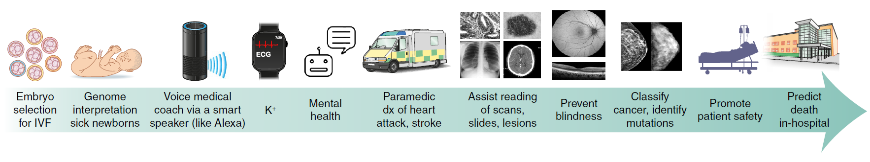
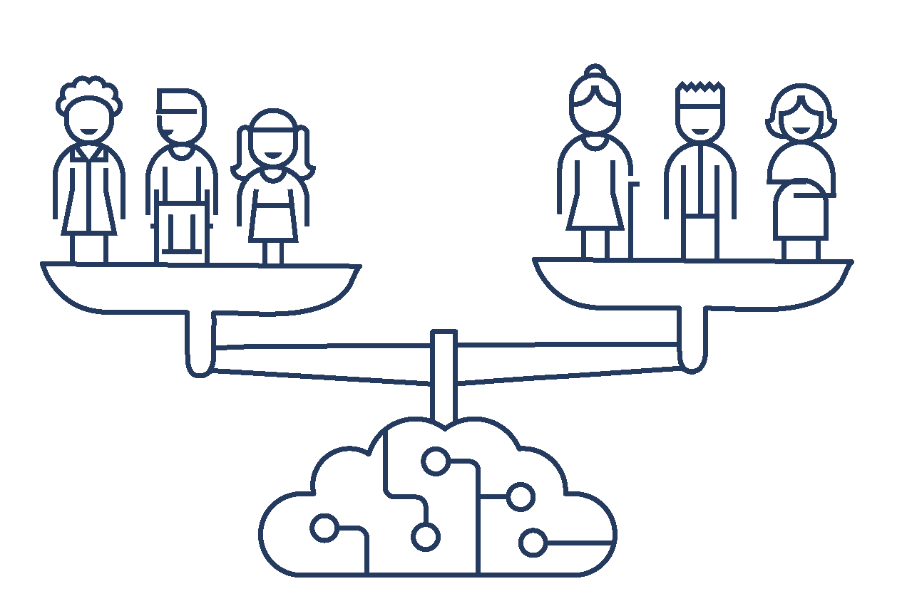
AI for Precision Medicine
source: www.microsoft.com
Eric J. Topol. Nature Medicine (2019)

Slide 47
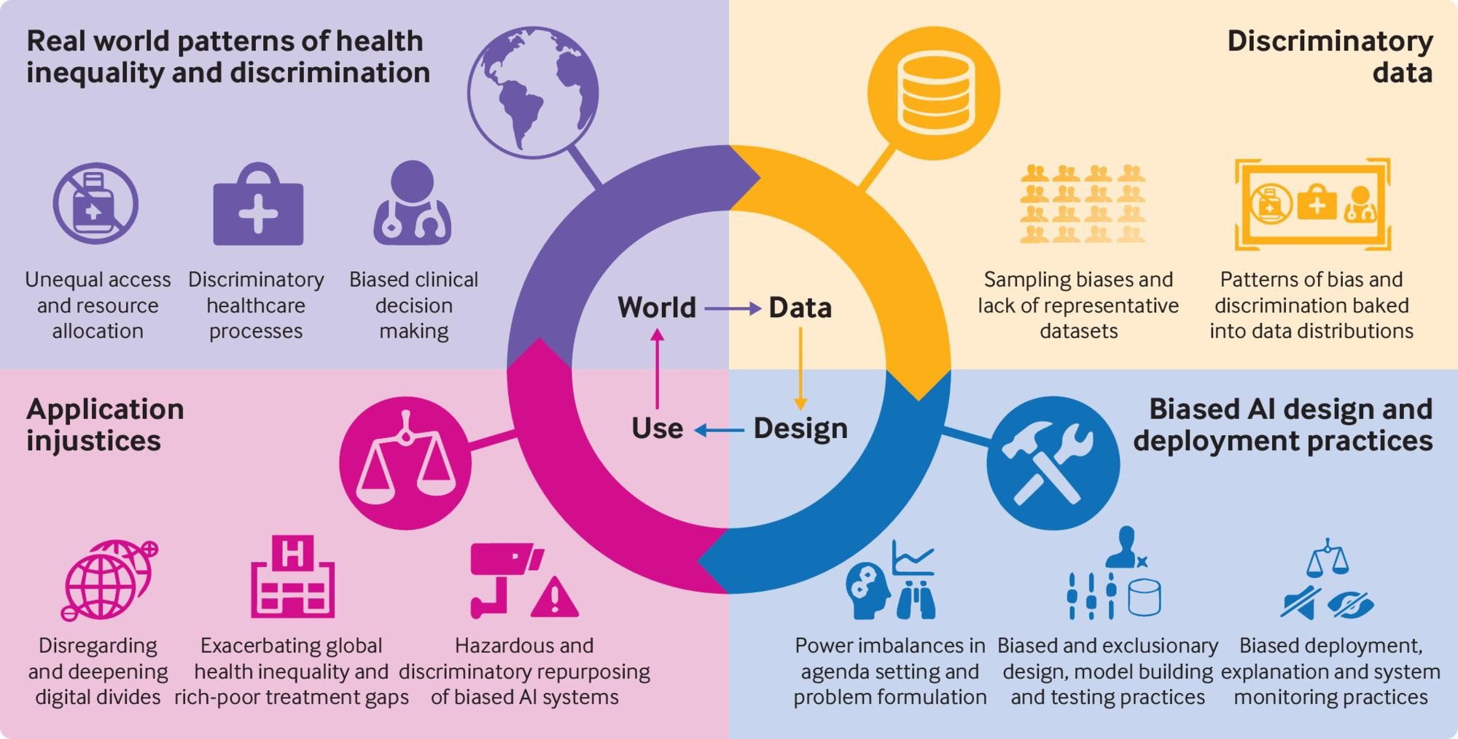
BMJ 2021;372:n304

Slide 48
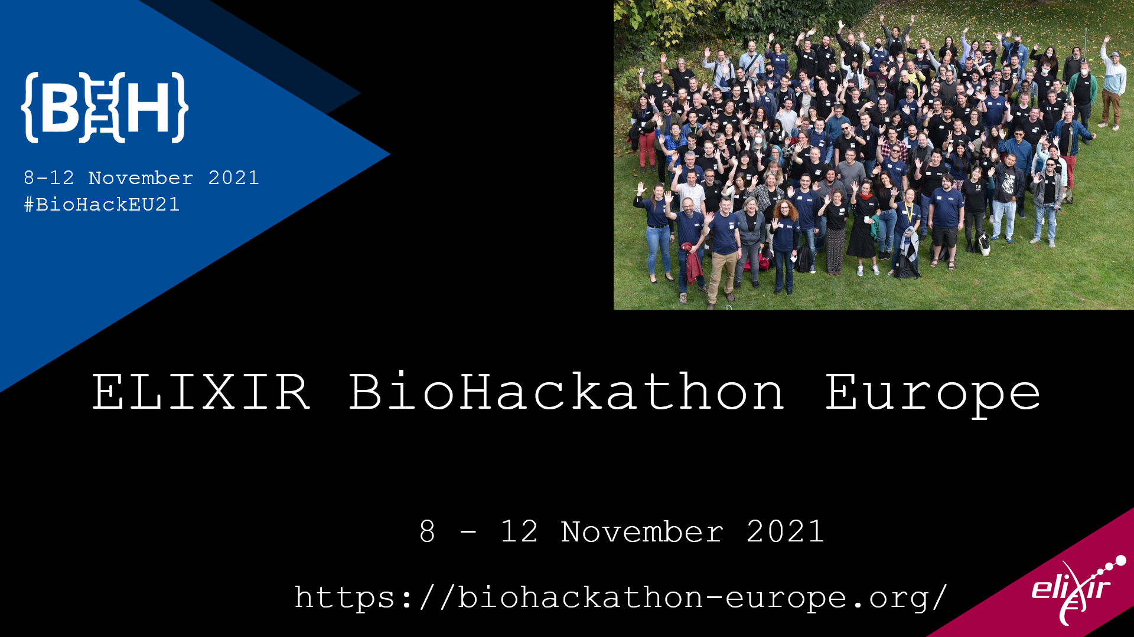

Slide 49
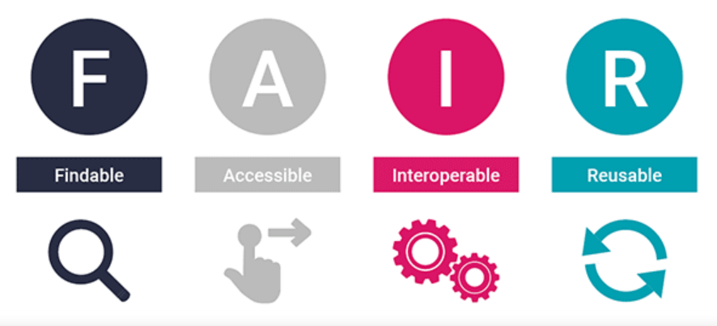
Our challenge
“FAIRX: Quantitative bias assessment in ELIXIR biomedical data resources”

Slide 50
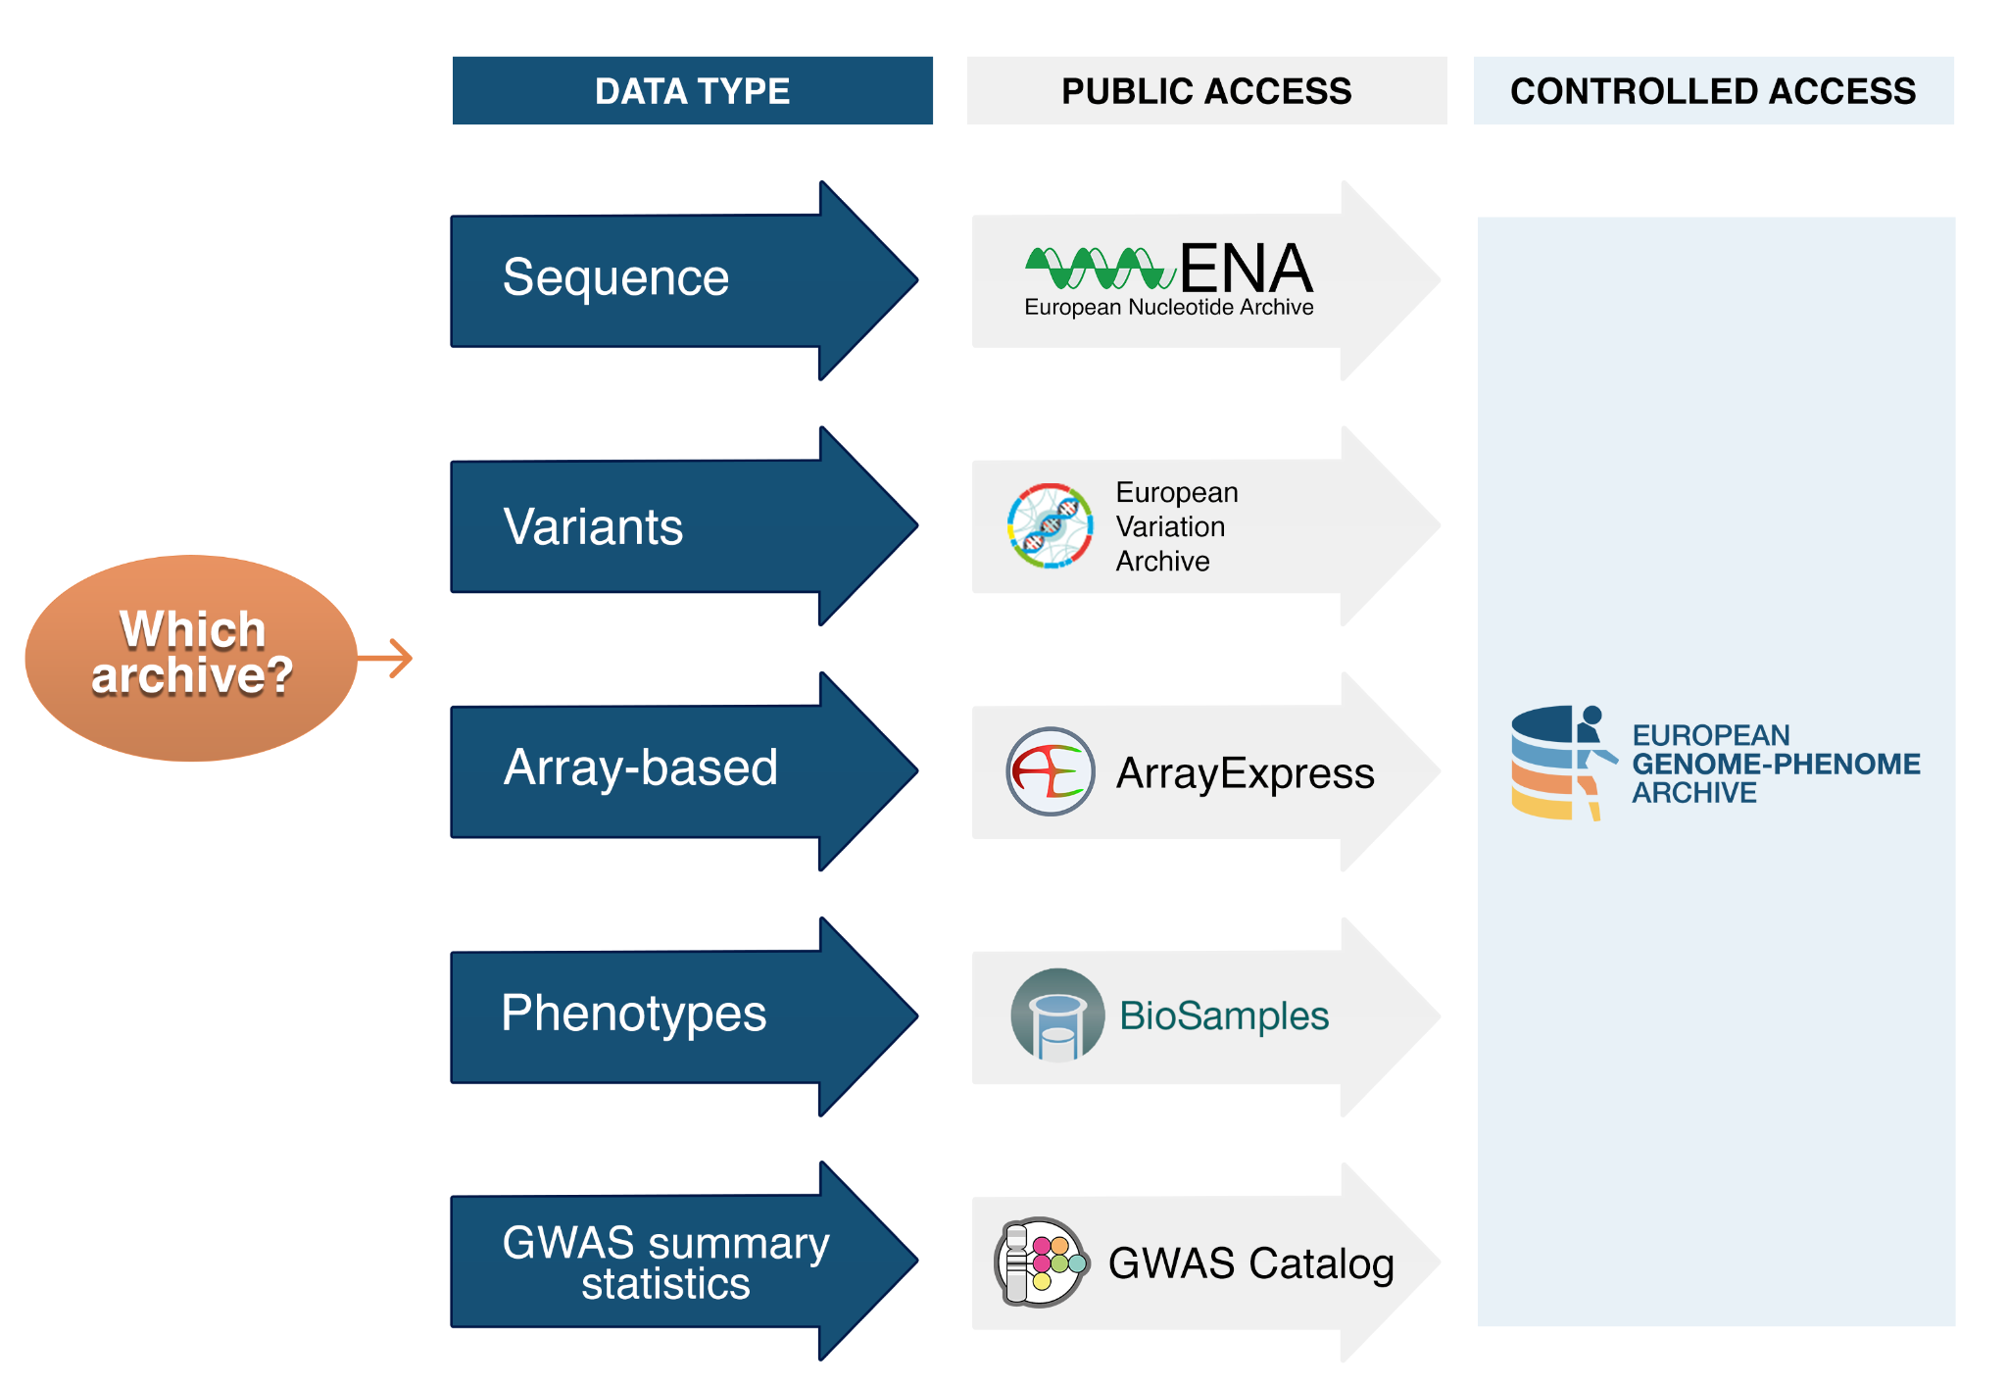




Human data collection
source: https://ega-archive.org/

Slide 51

Data and metadata

Slide 52
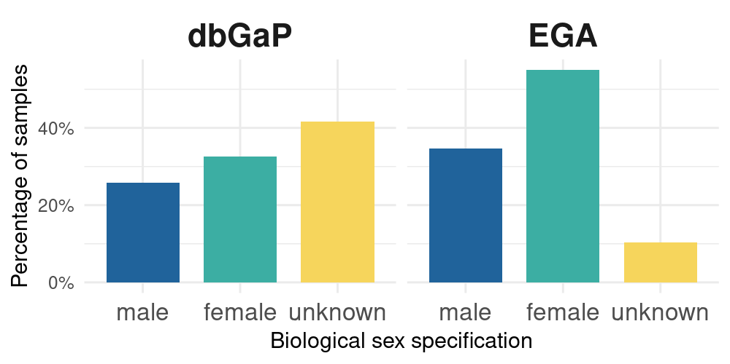
Comparing the two resources
7,036,375 total samples over 753 studies
1,249,255 total samples over 1,490 studies

Slide 53
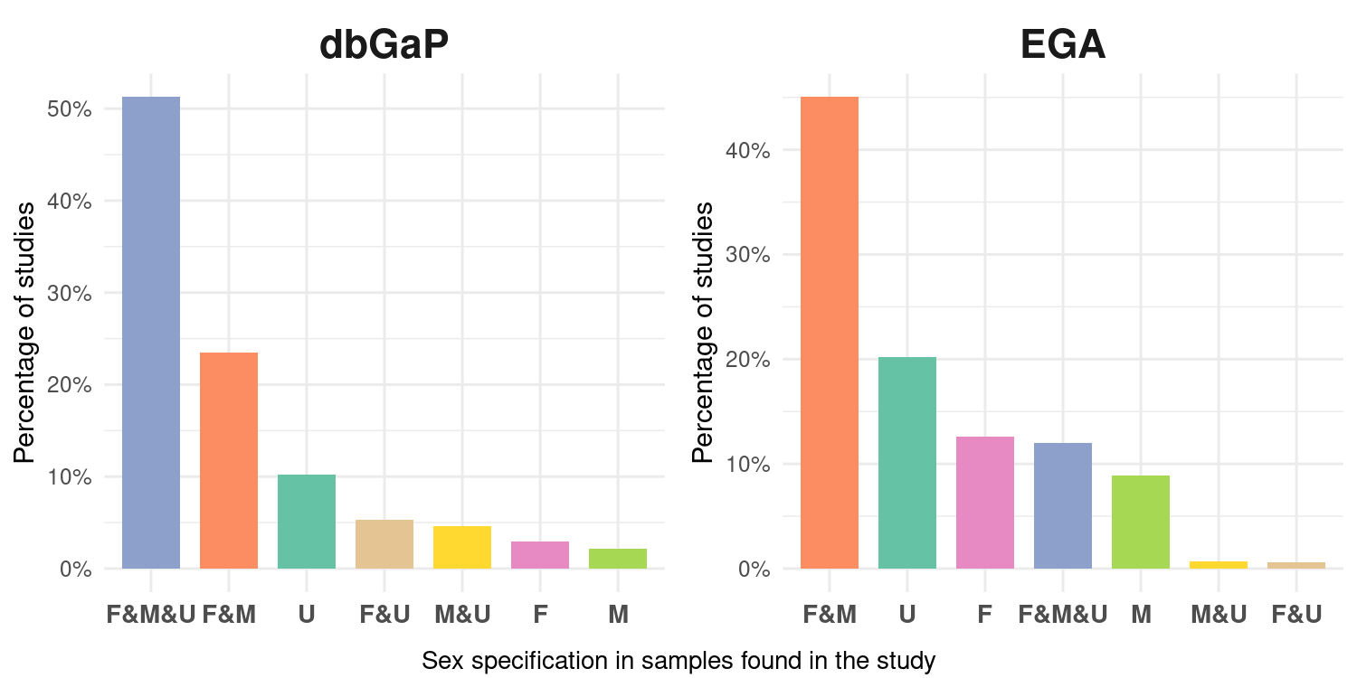
Comparing the two resources
F = female
M = male
U = unknown

Slide 54


Slide 55


Slide 56


Slide 57



Sex bias awareness of
biological repositories users

Slide 58


Slide 59


Slide 60


Sex analysis
Gender analysis
Tannenbaum, C., Ellis, R.P., Eyssel, F. et al. Sex and gender analysis improves science and engineering.
Nature 575, 137–146 (2019). https://doi.org/10.1038/s41586-019-1657-6

Slide 61
FAIR-X principles
Clear definitions
Sex as a biological characteristic; gender as sociocultural behavior, attitude and identity
Standards
Improve data management and quality
Privacy preservation
Scientific research aligned with the ethical and regulatory framework
Transparency
Promote open science and access, reuse. Create easy-to-use quality indicators for dataset creators and curators
Education
Create awareness and knowledge
Social impact
Analyze, understand, spread the effects of precision medicine in underrepresented communities.
Stakeholder engagement
Include participatory and multidisciplinary methods in the phases of design, development, validation and use.
Allow interoperability, reuse and open access.
Avoid confusion in data collection and processing.
GDPR, anonymization techniques, synthetic data, genomic data.
Include diversity in data set creation, research practice, and university curricula
Active intervention in decision making
Improve accountability
Find solutions and build trust

Slide 62

Conclusions

